Slide 1
Evaluation of MEV Mitigation Technique
Presented by
Mohammad Saad Azam
Supervisor: Dr. Vincent Gramoli
School of Computer Science

Slide 2
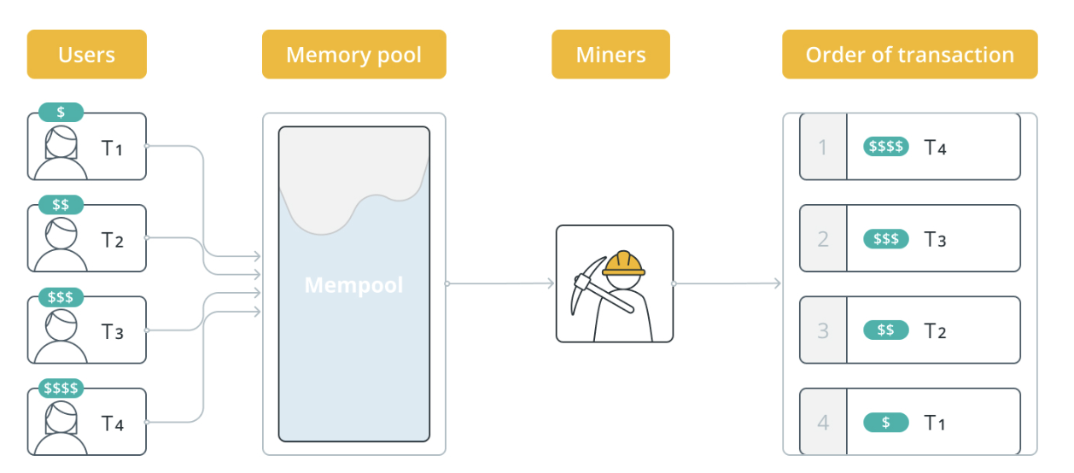
Motivation – MEV and its Impact
Untapped Resources: MEV (Maximal Extractable Value) refers to value that can be extracted by reordering, inserting, or censoring transactions in a blockchain.
Manipulatable by Transaction Ordering: The ability to control transaction sequencing allows validators to exploit opportunities, often at the expense of fairness and user profits.

Slide 3
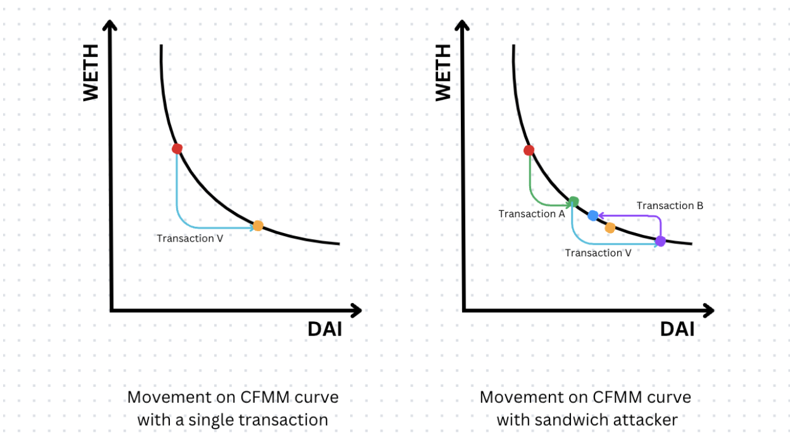
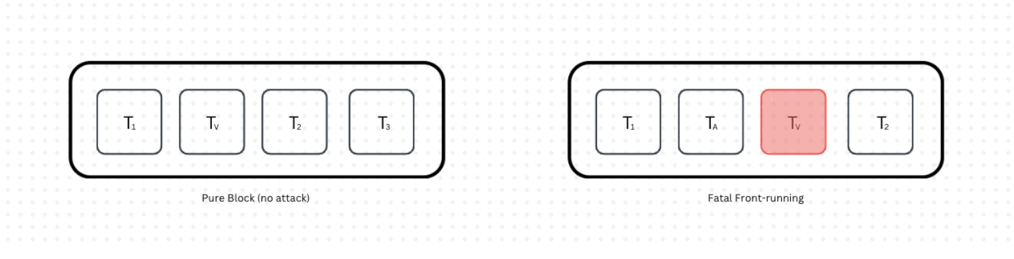
Automated Market Makers
CFMM-Based DEXs: determine trade prices based on reserve ratios
Sandwich Attacks: exploit transaction positions in the pool, extract profits at the expense of users
Front-Running Attacks: exploit transaction ordering by placing trades ahead of user transactions, rendering them less effective or invalid
Sandwiching transactions
Front-running transactions

Slide 4
Background literature
MEV Exploitation:
Literature exploring MEV bots [FlashBoys2.0]
Survey MEV attack surfaces [HowDarkIsTheForest]
Formalize MEV extraction [Specter]
Survey existing mitigation techniques [Preventing Transaction Reordering]

Slide 5
Mitigation Techniques:
There exist several proposed mitigation techniques
Some require change in protocols
Solutions like [Lyra], [Themis], [Pompeii]
Not all guard against a rushing adversary
Others can be adapted into existing blockchains
Commit-and-Reveal schemes obfuscate transaction details
Time-based fairness consolidate ordering based on when the transactions arrive at a majority of nodes
Third party services which centralize the ordering, like Flashbots, Eden or OpenMEV
Most proposed solutions are tested theoretically and not on real-world scenarios

Slide 6
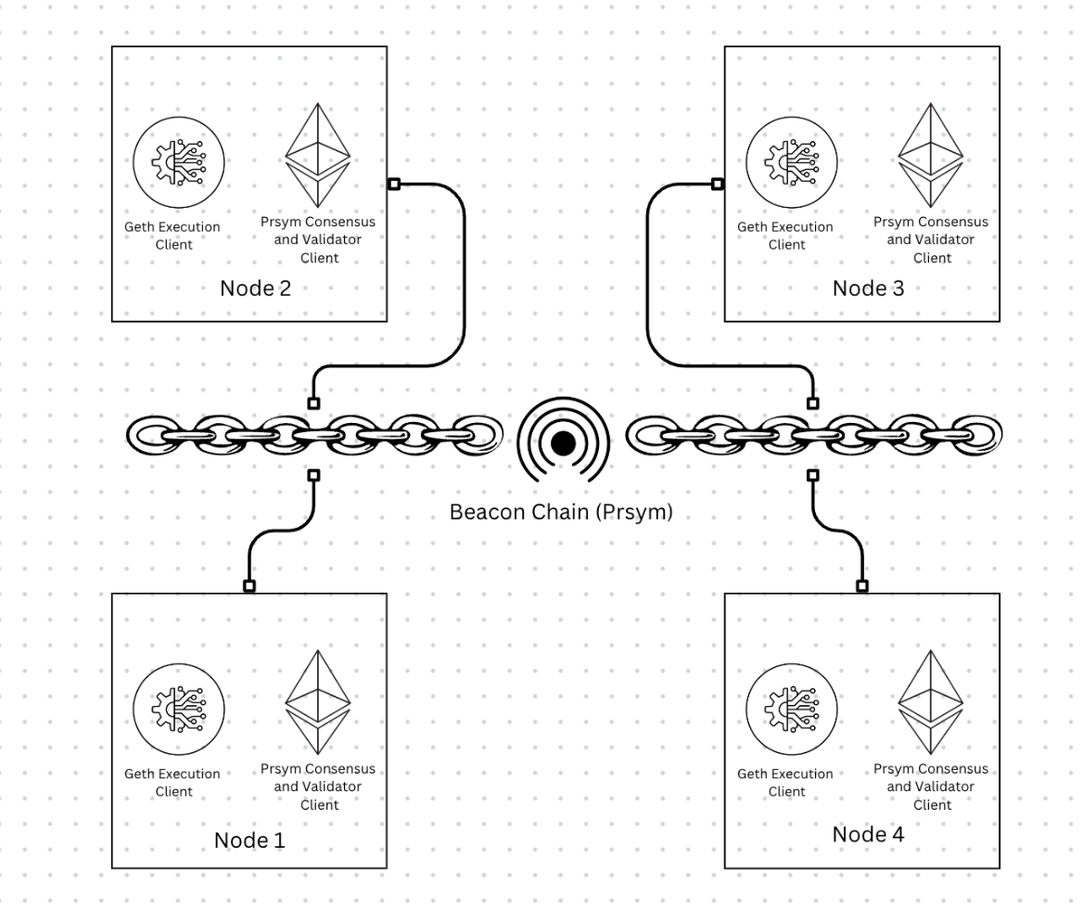
Methodology
We evaluate a proposed mitigation technique, “Eating Sandwiches: Modular and lightweight elimination of transaction reordering attacks ”, in a real-world setting
Our test network consists of 4 full nodes, using Geth and Prysm

Slide 7
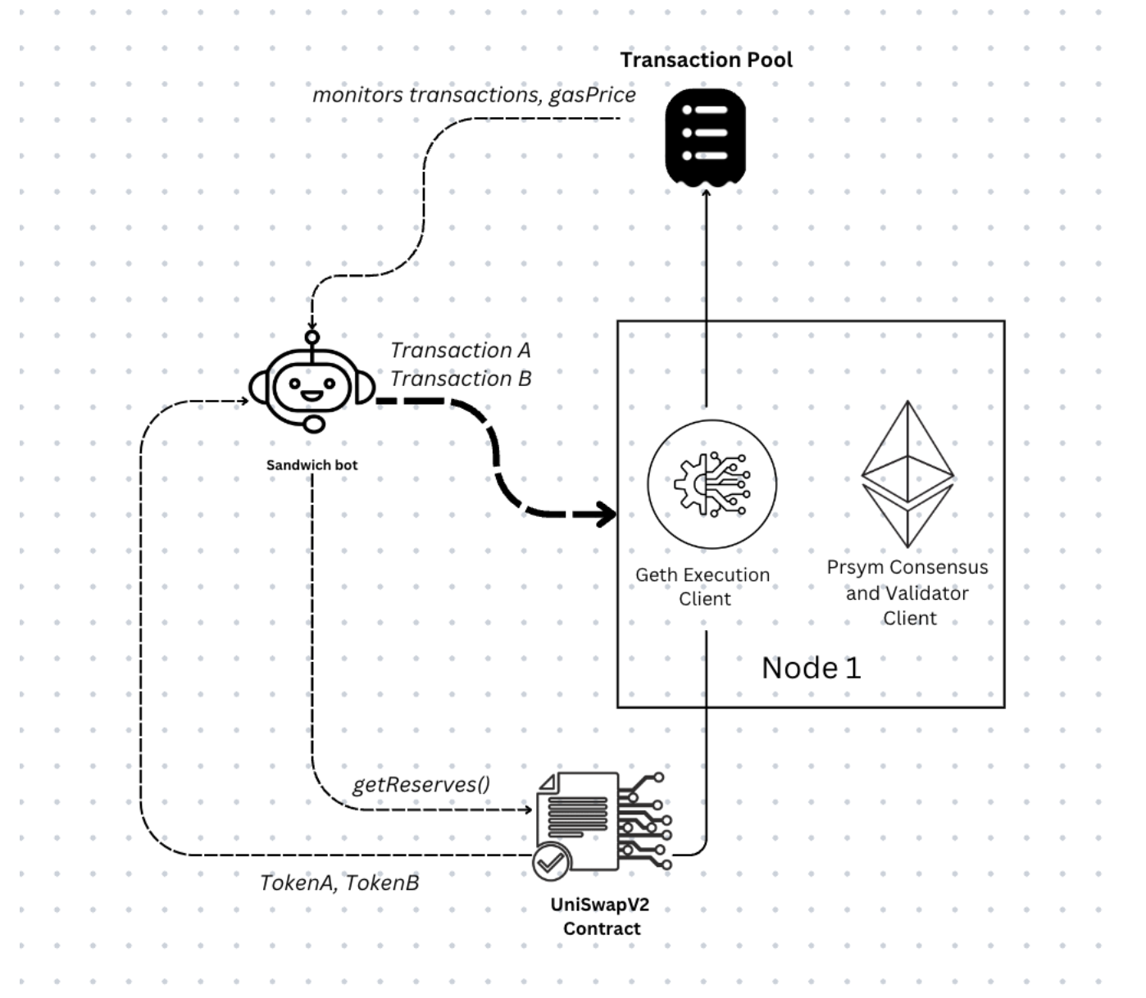
We deploy UniSwap V2 contracts, and several other helping contracts
We also deploy a custom sandwich bot to monitor the transaction pool and mount sandwiching attacks on viable swaps

Slide 8
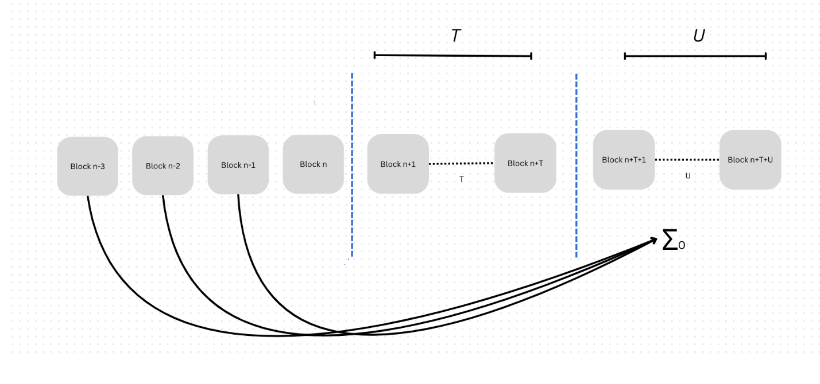
Implementation of protocol
Protocol makes use leaders from previous blocks to generate partial seeds
Commitment to the seeds are stored and once the block is mined the ordering is determined with the new combined seed

Slide 9
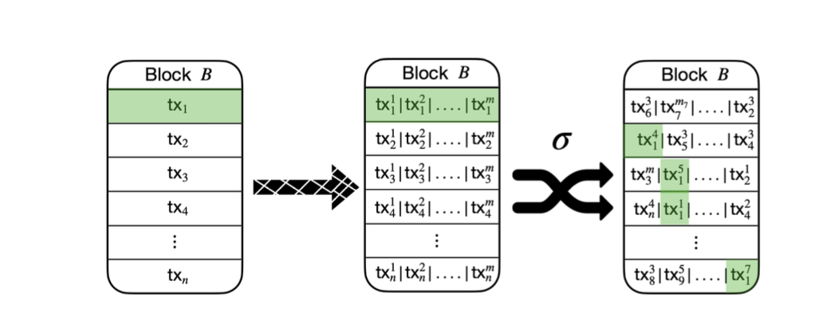
The transactions in the block are then chunked
The chunked transactions are then permuted according to the random value

Slide 10
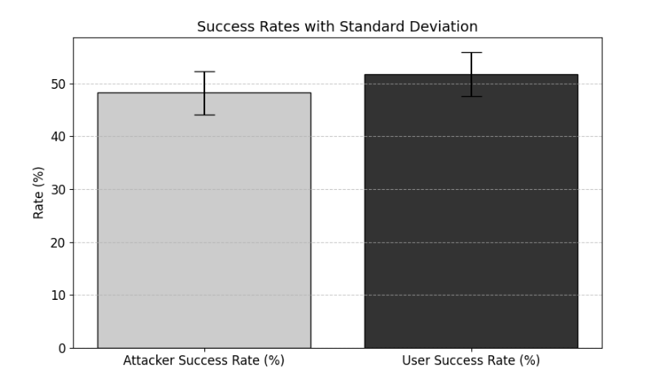
Results
Fatal Front-running:
Deploy a custom contract to simulate an atomic smart contract
Run the experiment on unmodified setup
Repeat on modified setup

Slide 11
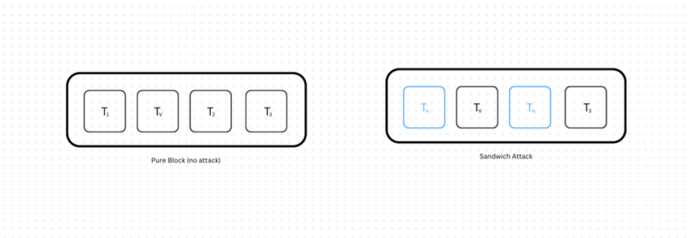
Results
Sandwich attack
Simulate DAI/WETH Uniswap pool from 3 weeks of Etherscan data
Repeat the test on vanilla setup and modified setup
Vary the chunk size to evaluate effects of chunk size

Slide 12
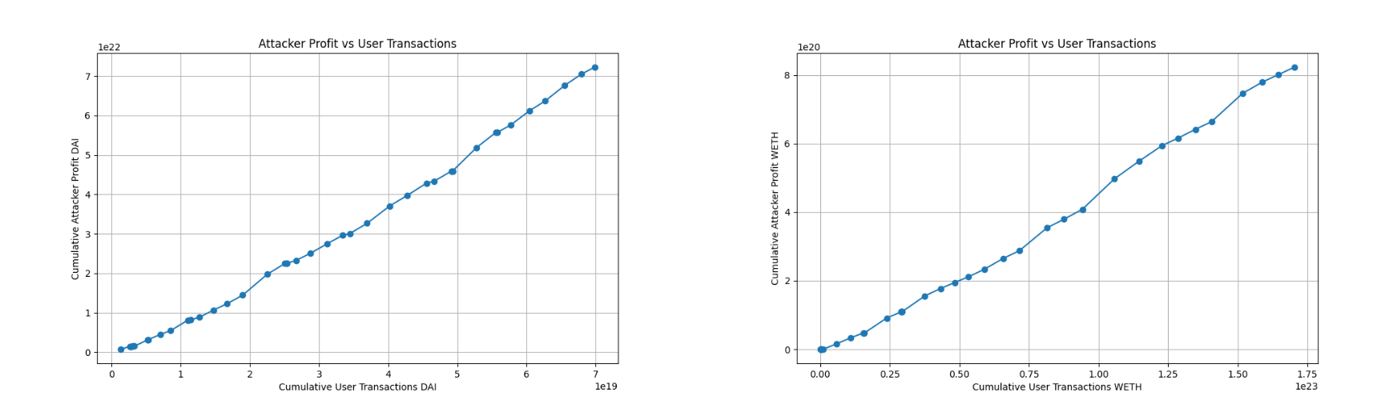
Default behavior (no mitigation)
Clear results indicating increasing profit with increasing user transaction amount; higher the amount greater the slippage

Slide 13
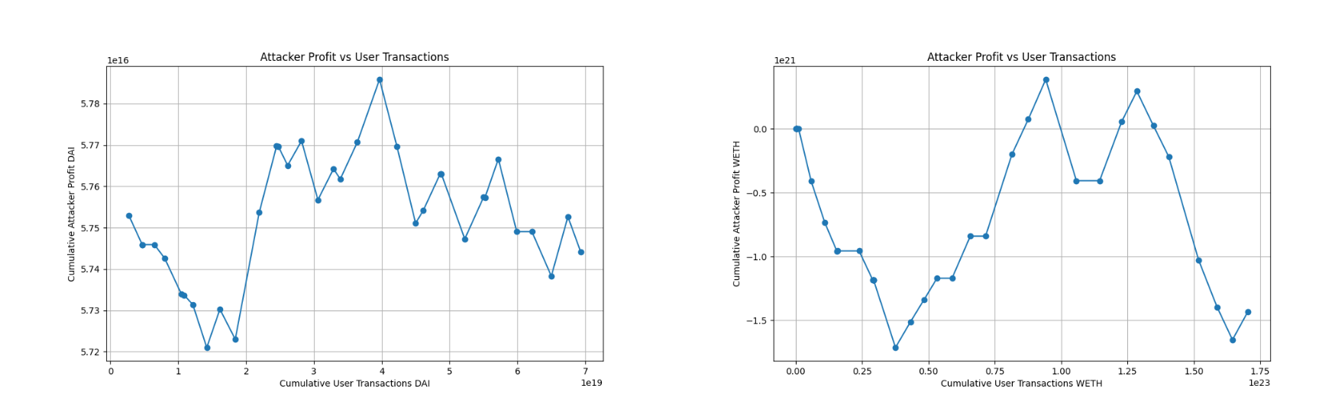
Reordering only (chunk size = 1)
Results indicate effectiveness of reordering, attacker profits no longer guaranteed
Profit or loss vary in size
1/6 likely to make profit
1/6 likely to lose money (user makes profit)
4/6 to either make 0, or some amount in between

Slide 14
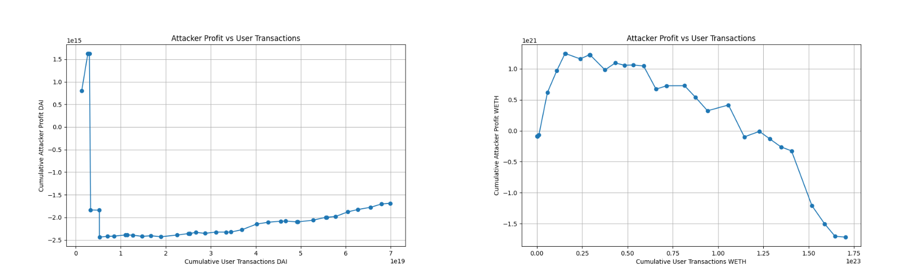
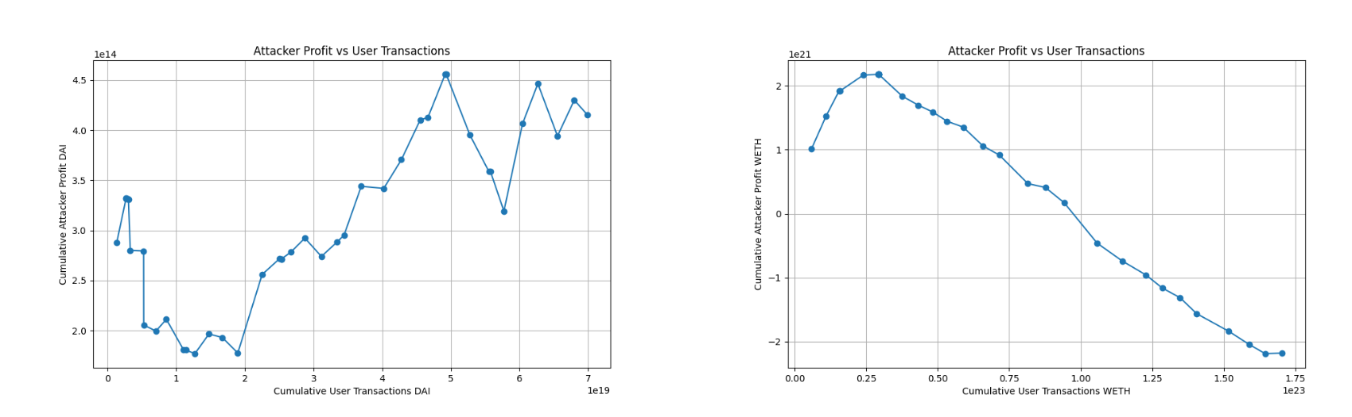
Reordering only (chunk size = 3)
Results indicate effectiveness of chunking – changes in profit/loss become much smaller
Dependent on original user transaction amount
Reordering only (chunk size = 6)

Slide 15
Discussion
Scope:
Can address any sort of MEV attack, regardless of inner workings
Transactions still made public hence attacker has 50% of success for fatal-front runs
Attacker will still launch attacks if expected return outweighs potential losses (gas fee if attack fails)
Compared to commit-reveal, this is a disadvantage
Sandwich attacks (or attacks leveraging slippage) eliminated completely
Attacker as likely to make a profit or loss
Chunking reduces amount of profit/loss

Slide 16
Discussion
Jostling:
Eliminates sandwich attacks
PGAs (Priority Gas Auction) eliminated completely as gas fee no longer determines position in a block
Leads to decreased competition for block space
More genuine transactions get included
Eliminates artificial gas price inflation

Slide 17
Discussion
Jostling and Goodput:
Eliminates sandwich attacks
PGAs (Priority Gas Auction) eliminated completely as gas fee no longer determines position in a block
Leads to decreased competition for block space
More genuine transactions get included
Eliminates artificial gas price inflation
Negligible additional overhead (only on-chain space for seeds)
Goodput stays high

Slide 18
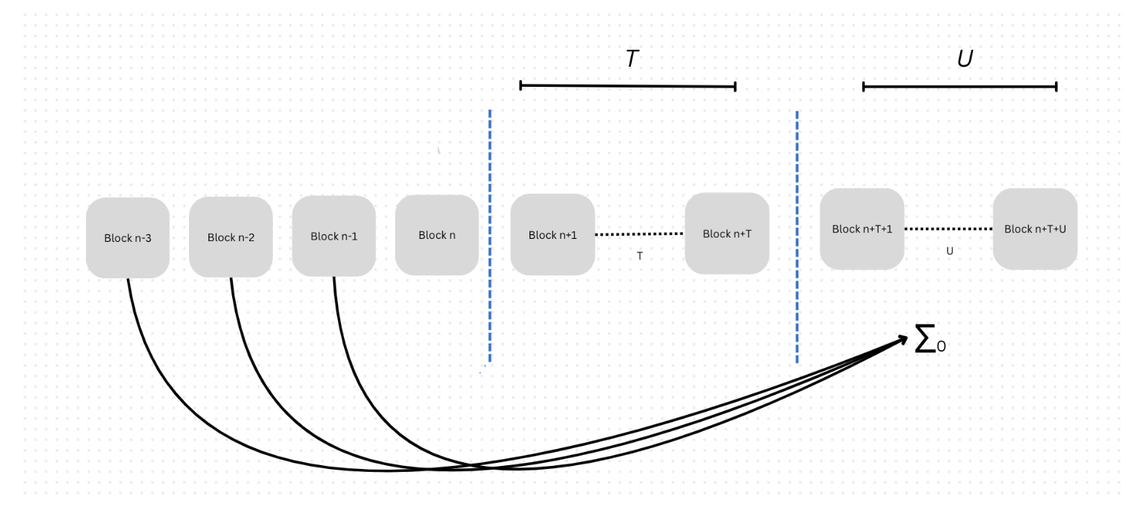
Discussion
Delay:
Requires U number of blocks for finalization
Exact parameter can be tweaked, at least one block
On Ethereum, can be swapped for RANDAO

Slide 19
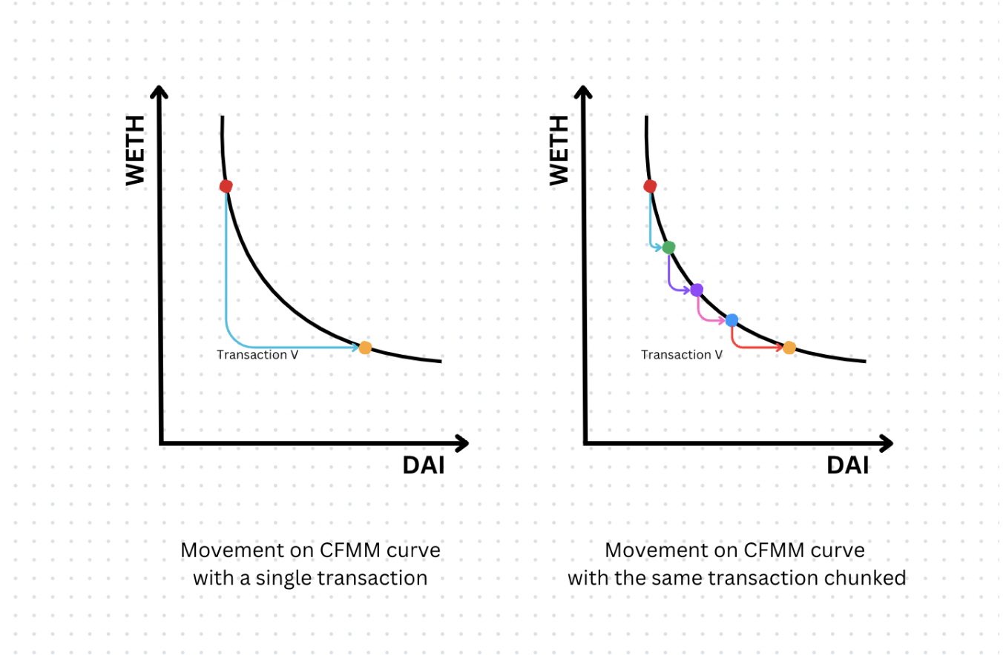
Discussion
Cost:
Introduces no extra cost to the blockchain
For regular swaps (on CFMM based DEXes), introduces addition (expected) slippage

Slide 20
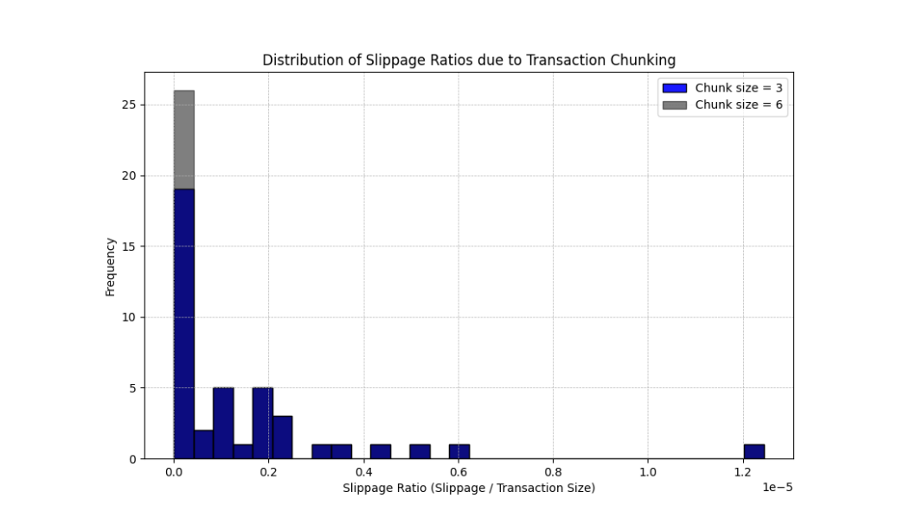
Discussion
Cost:
Slippage higher for transactions of bigger size – constant depending on the chunk size
Negligible for real-world scenarios

Slide 21
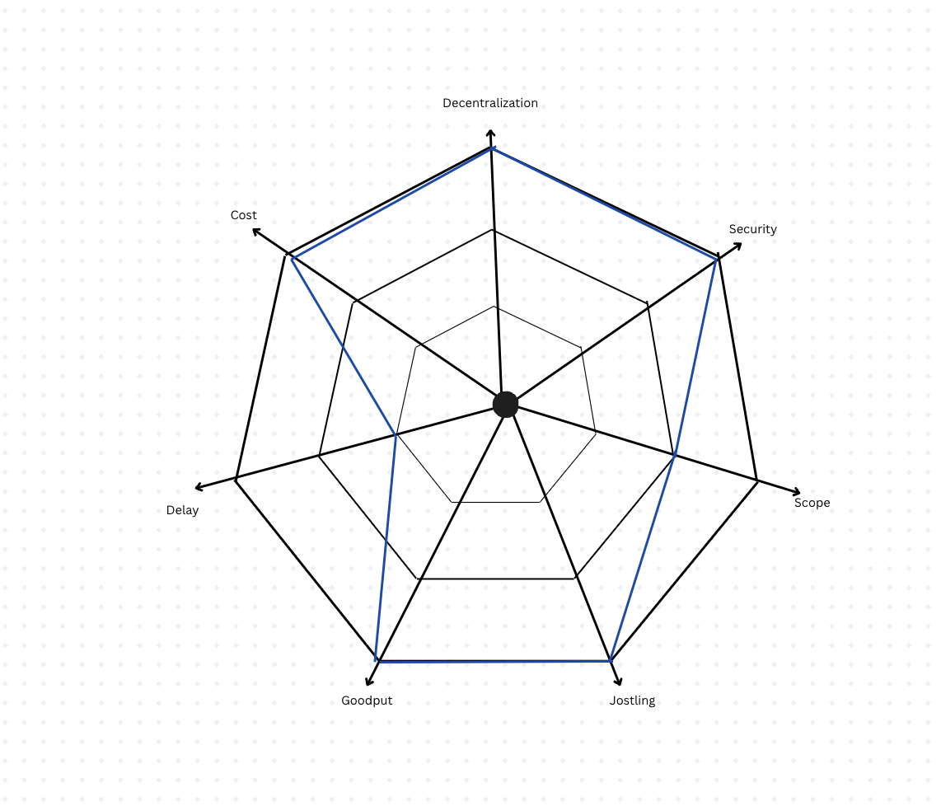
Conclusion
Can be implemented on existing blockchain without introducing consensus changes
(Fatal) Front-running becomes a gamble, however not eliminated entirely
Introduces a minimum of one block of delay
May or may not be acceptable depending on blockchain requirements

Slide 22
Future work
Ethereum already has a randomness generator built in, RANDAO
Not perfect, however control over RANDAO is limited to one bit – sufficient entropy for hash functions
Protocol can be upgraded to rely on only one leader
Bigger dataset for evaluation, different AMMs

Slide 23
Questions
Thank you!

